Slide 1
Total Quality Management
This chapter explains the concepts, principles, and philosophy of total quality management.

Slide 2
Total Quality Management
The way of managing organization to achieve excellence
Total – everything
Quality – degree of excellence
Management – art, act or way of organizing, controlling, planning, directing to achieve certain goals

Slide 3
Definition of TQM (BS4778:1991)
A management philosophy embracing all activities through which the needs and expectations of the CUSTOMER and COMMUNITY, and the objectives of the organization are satisfied in the most efficient and cost effective manner by maximising the potential of ALL employees in a continuing drive for improvement.”

Slide 4
Total Quality Management
Quality element | Previous state | TQM
Definition | Product-oriented | Customer-oriented
Priorities | Second to service and cost | First among equals of service and cost
Decisions | Short-term | Long-term
Emphasis | Detection | Prevention
Errors | Operations | System
Responsibility | Quality Control | Everyone
Problem solving | Managers | Teams
Procurement | Price | Life-cycle costs
Manager’s role | Plan, assign, control, and enforce | Delegate, coach, facilitate, and mentor

Slide 5
Total Quality Management
Requires cultural change – prevention not detection, pro-active versus fire-fighting, life-cycle costs not price, etc
Many companies will not start this transformation unless faced with disaster/problems or forced by customers

Slide 6
Effect of Quality Improvement
Improve Quality (Product/Service)
Increase Productivity (less rejects, faster job)
Lower Costs and Higher Profit
Business Growth, Competitive, Jobs, Investment

Slide 7
Increase in productivity with improved quality
Item | Before Improvement – 10% nonconforming | After improvement – 5% nonconforming
Relative total costs of 20 units | 1.00 | 1.00
Conforming units | 18 | 19
Relative cost of non-conforming units | 0.10 | 0.05
Productivity increase |  | 1/18(100)=5.6%
Capacity increase |  | 1/18(100)=5.6%
Profit increase |  | 1/18(100)=5.6%

Slide 8
TQM
Principles & Practices
Tools & Techniques
Leadership
Quantitative
Non-quantitative
Customer satisfaction
SPC
ISO 9000
Employee improvement
Acceptance Sampling
ISO 14000
Continuous improvement
Reliability
Benchmarking
Experimental design
Total productive maintenance
Supplier partnership
FMEA
Management tools
Performance measures
QFD
Concurrent engineering
Scope of the TQM activity

Slide 9
TQM Six Basic Concepts
Leadership
Customer Satisfaction
Employee Involvement
Continuous Process Improvement
Supplier Partnership
Performance Measures
(All these present an excellent way to run
a business)

Slide 10
Criteria 1
Leadership
Top management must realize importance of quality
Quality is responsibility of everybody, but ultimate responsibility is CEO
Involvement and commitment to CQI
Quality excellence becomes part of business strategy
Lead in the implementation process

Slide 11
Characteristics of Successful Leaders
Give attention to external and internal customers
Empower, not control subordinates. Provide resources, training, and work environment to help them do their jobs
Emphasize improvement rather than maintenance
Emphasize prevention
Encourage collaboration rather than competition
Train and coach, not direct and supervise
Learn from problems – opportunity for improvement
Continually try to improve communications
Continually demonstrate commitment to quality
Choose suppliers on the basis of quality, not price
Establish organisational systems that supports quality efforts

Slide 12
Implementation Process
Must begin from top management, most important CEO commitment
Cannot be delegated (indifference, lack of involvement cited as principle reason for failure)
Top/senior management must be educated on TQM philosophy and concepts, also visit successful companies, read books, articles, attend seminars
Timing of implementation – is the org ready, re-organization, change in senior personnel, current crisis – then need to postpone to favourable time
Need a roadmap/framework for implementation
Formation of Quality Council – policies, strategies, programmes

Slide 13
Implementation Process
Quality council job–
  Develop core values, vision statement, mission statement, and quality policy statement
  Develop strategic long-term plan with goals and annual quality improvement program with objectives
  Create total education and training plan
  Determine and continually monitor cost of poor quality
  Determine performance measures for the organization, approve them for functional areas, and monitor them.
  Continually determine projects that improve processes, particularly those affect external and internal customer satisfaction
  Establish multifunctional project and departmental or work group teams and monitor progress
  Establish or revise the recognition and reward system to account new way of doing business. Must begin from top management, most important CEO commitment

Slide 14
Implementation Process
Core values
- foster TQM behaviour and define the culture
- need to develop own values
Examples from Malcolm Baldrige National Quality Award
  Customer-driven excellence
  Visionary leadership
  Organizational and personal learning
  Valuing employees and partners
  Agility
  Management for innovation
  Management by fact
  Systems perspective
  Social responsibility
  Focus results and creating value

Slide 15
Criteria 2
Customer Satisfaction
Customer is always right – in Japan customer is “King”
Customer expectations constantly changing – 10 years ago acceptable, now not any more!
Delighting customers (Kano Model)
Satisfaction is a function of total experience with organization
Must give customers a quality product or service, reasonable price, on-time delivery, and outstanding service
Need to continually examine the quality systems and practices to be responsive to ever – changing needs, requirements and expectations – Retain and Win new customers

Slide 16
Issues for customer satisfaction
Checklist for both internal and external customers
Who are my customers?
What do they need?
What are their measures and expectations?
Does my product/service exceed their expectations?
How do I satisfy their needs?
What corrective action is necessary?

Slide 17
Customer Feedback
To focus on customer, an effective feedback program is necessary, objectives of program are to:
    Discover customer dissatisfaction
    Discover priorities of quality, price, delivery
    Compare performance with competitors
    Identify customer’s needs
    Determine opportunities for improvement

Slide 18
Customer Feedback Tools/Method
Warranty cards/Questionnaire
Telephone/Mail Surveys
Focus Groups
Customer Complaints
Customer Satisfaction Index
Good experience are told to 6 people while bad experience are repeated to 15 people

Slide 19
Criteria 3
Employee Involvement
People – most important resource/asset
Quality comes from people
Deming – 15% operator errors, 85% management system
Project teams – Quality Control Circles (QCC), QIT
Education and training – life long, continuous both knowledge and skills
Suggestion schemes; Kaizen, 5S teams
Motivational programmes, incentive schemes
Conducive work culture, right attitude, commitment

Slide 20
Criteria 4
Continuous Process Improvement
View all work as process – production and business
Process – purchasing, design, invoicing, etc.
Inputs – PROCESS – outputs
Process improvement – increased customer satisfaction
Improvement – 5 ways; Reduce resources, Reduce errors, Meet expectations of downstream customers, Make process safer, make process more satisfying to the person doing

Slide 21
Continuous Improvement
Inputs – processing – outputs
feedback
Process
Work methods
Procedures
Tools
Production – Cutting, Welding, etc.
Bank – deposit/withdrawal process,
Kad Pintar Application Process at NRD
Outputs
Products
Delivered service
In-process jobs – forms signed, drawing completed
Others
Also by-products, wastes
Input
Materials
Info, Data
People
Money
Conditions

Slide 22
Problem – Solving Method
Identify the opportunity (for improvement)
Analyze the current process
Develop the optimal solution(s)
Implement changes
Study the results
Standardize the solution
Plan for the future

Slide 23
Identify the opportunity (for improvement)
Phase 1 – Identify problems
Use Pareto Analysis – external & internal failures, returns
Phase 2 – Form a team (same function of multifunctional)
Phase 3 – Define scope of problem (Paint process – data collected for a week showed high 30% ‘runs’ defect)

Slide 24

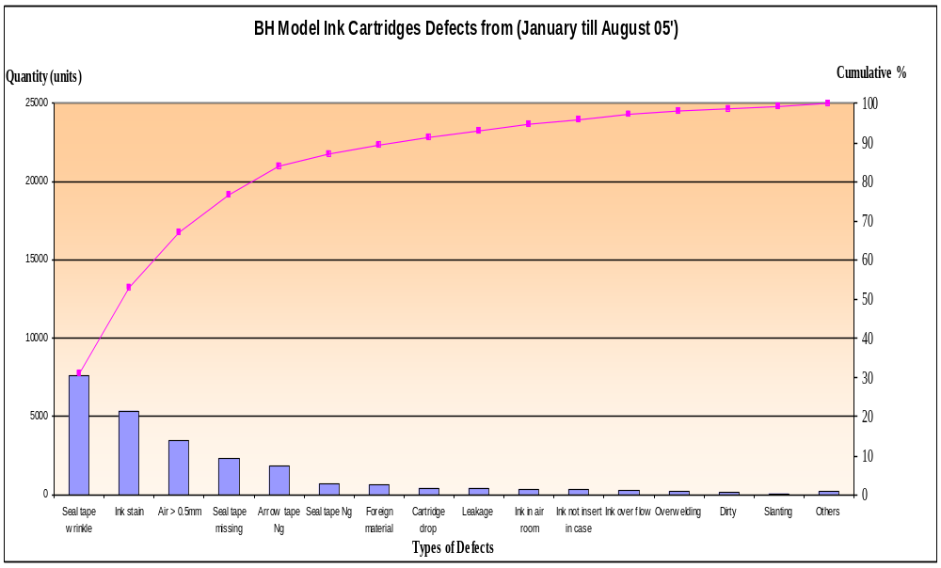
Pareto Diagram Example

Slide 25
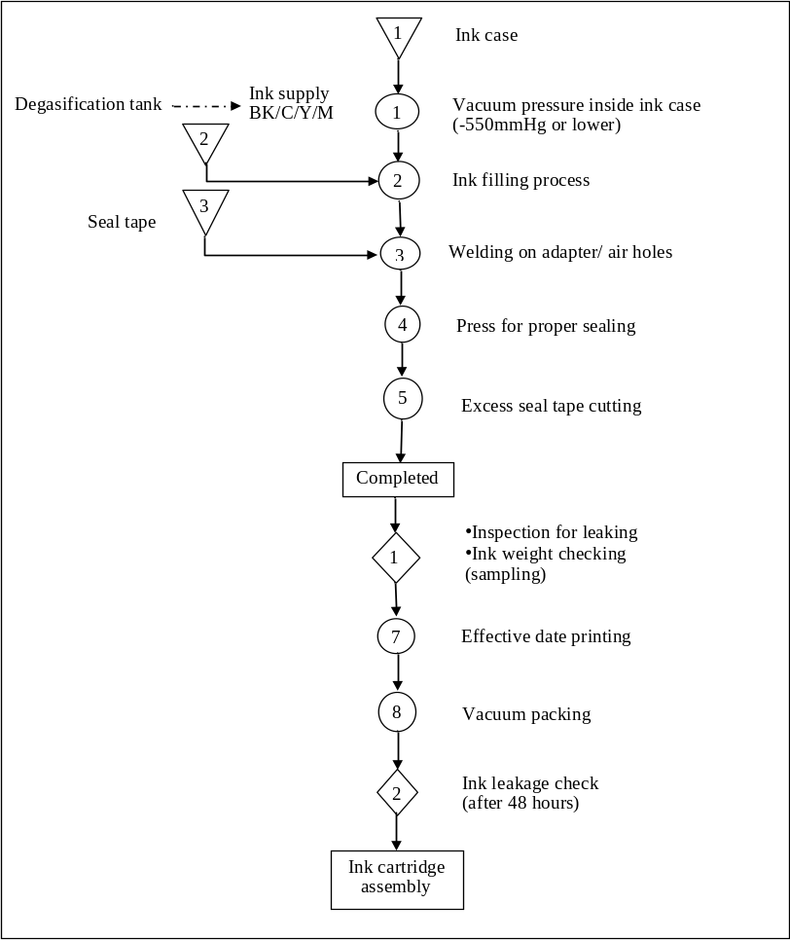
Process Flow Chart – Ink filling process

Slide 26
Analyze the current process
Understand the current process, how it is performed
Develop process flow diagram
Define target performance
Collect data, information
Determine causes not solution (use cause and effect diagram)
Root cause if possible

Slide 27
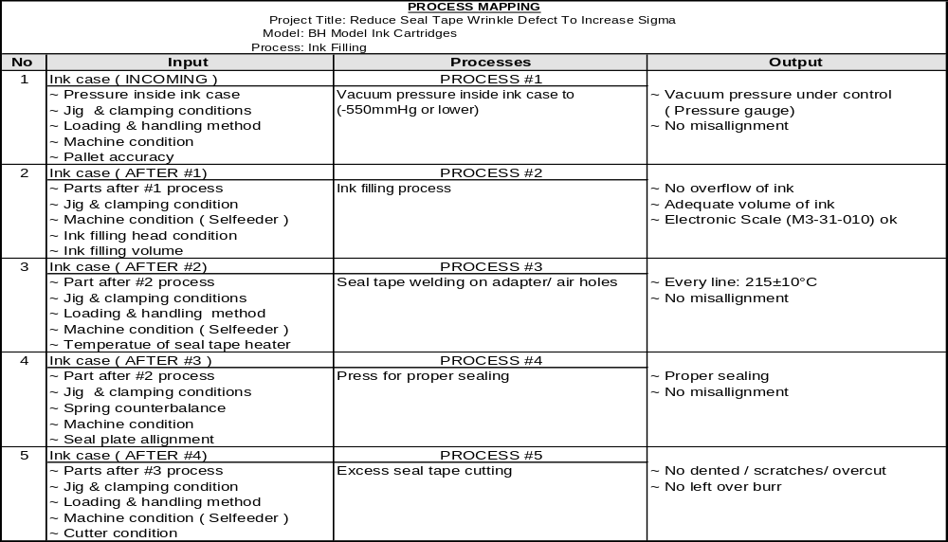

Slide 28
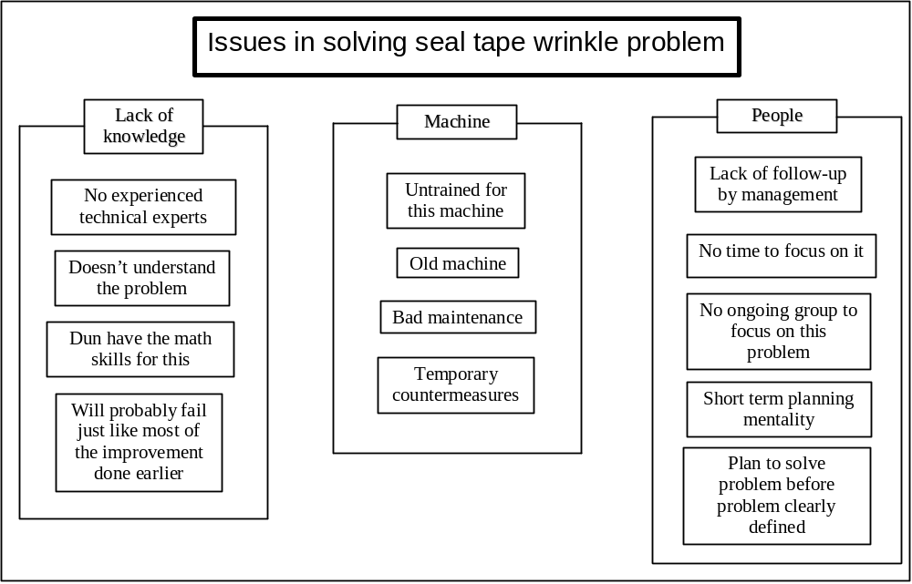
Affinity diagram Example

Slide 29
Develop the optimal solution(s)
To establish solutions
Recommended optimal solution to improve process
Create new process, combine different process, modify existing process
Creativity (rubber pad adhesive, door trim)
Brainstorming, Delphi, Nominal Group Technique
Evaluate and testing of ideas/possible solutions
Implement changes
To prepare implementation plan, obtain approval, conduct process improvements, study results
Why is it done? How, When, Who, When it will be done?

Slide 30
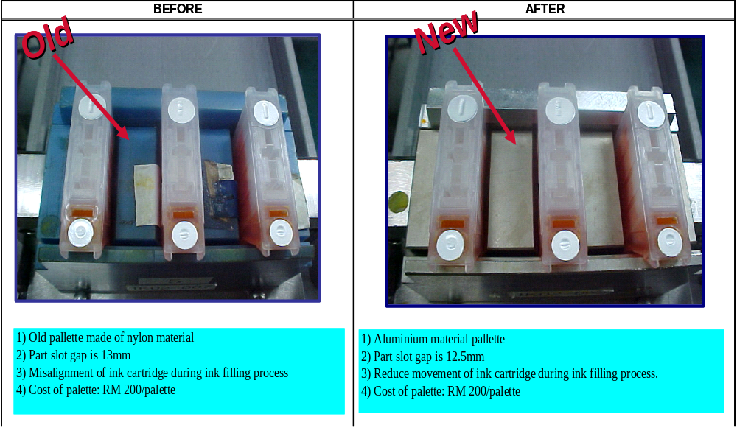

Slide 31
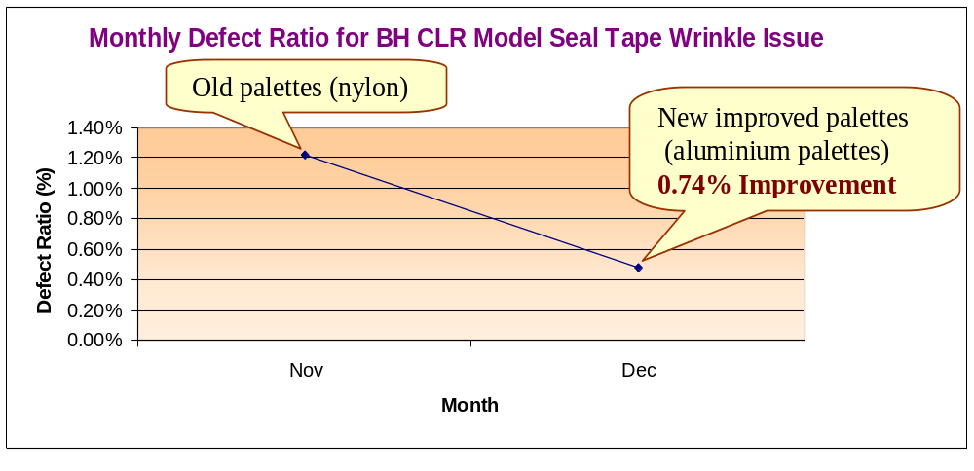
Effects of Improvement

Slide 32
Study the results/Standardize the solution/Plan for the future
Measure and evaluate results of changes
Standardize solution – certify process, operator, done?
Next project/problem areas
Positron Control Wave Soldering Process
What | Specs | Who | How | Where | When
A 880 Flux | 0.864 g 0.008 | Lab technician | Specific gravity | Lab | Daily

Slide 33
Criteria 5
Supplier Partnership
40% product cost comes from purchased materials, therefore Supplier Quality Management important
Substantial portion quality problems from suppliers
Need partnership to achieve quality improvement – long-term purchase contract
Supplier Management activities

Slide 34
Criteria 5
Supplier Partnership
Define product/program requirements;
  Evaluate potential and select the best suppliers
  Conduct joint quality planning and execution
  Require statistical evidence of quality
  Certify suppliers, e.g. ISO 900, Ford Q1
  Develop and apply Supplier Quality Ratings
    Defects/Percent non-conforming
    Price and Quality costs
    Delivery and Service

Slide 35
Criteria 6
Performance Measures
Managing by fact rather than gut feelings
Effective management requires measuring
Use a baseline, to identify potential projects, to asses results from improvement
E.g. Production measures – defects per million, inventory turns, on-time delivery
Service – billing errors, sales, activity times
Customer Satisfaction
Methods for measuring
Cost of poor quality
    Internal failure
    External failure
    Prevention costs
    Appraisal costs

Slide 36
Performance Measures
Award Models (MBNQA, EFQM, PMQA)
Benchmarking – grade to competitors, or best practice
Statistical measures – control charts, Cpk
Certifications
    ISO 9000:2000 Quality Mgt System
    ISO 14000 Environmental Mgt System,
    Underwriters Lab (UL), GMP
    QS 9000, ISO/TS 16949

Slide 37
Deming’s 14 Points for Management
Create constancy of purpose towards improvement of product and service with aim to be competitive, stay in business and provide jobs.
Adopt a new philosophy – new economic age, learn responsibilities and take on leadership for future change.
Cease dependence on inspection to achieve quality. Eliminate the need for inspection on a mass basis by building quality into product in the first palace.

Slide 38
Deming’s 14 Points for Management
End the practice of awarding business on the basis of price, instead, minimize total costs.
Improve constantly and forever the system of production and service, to improve quality and productivity, thus decreasing costs.
Institute training on the job
Institute leadership, supervision to help do a better job.
Drive out fear, everyone can work effectively for company.

Slide 39
Deming’s 14 Points for Management
Breakdown barriers between departments. Work as teams to foresee production problems.
Eliminate slogans, exhortations, and targets for workforce.
Eliminate numerical quotas on the workforce.
Remove barriers that rob people pride of workmanship.
Institute a vigorous program of education and self-improvement.
Put everybody to work to accomplish the transformation.

